Slide 1


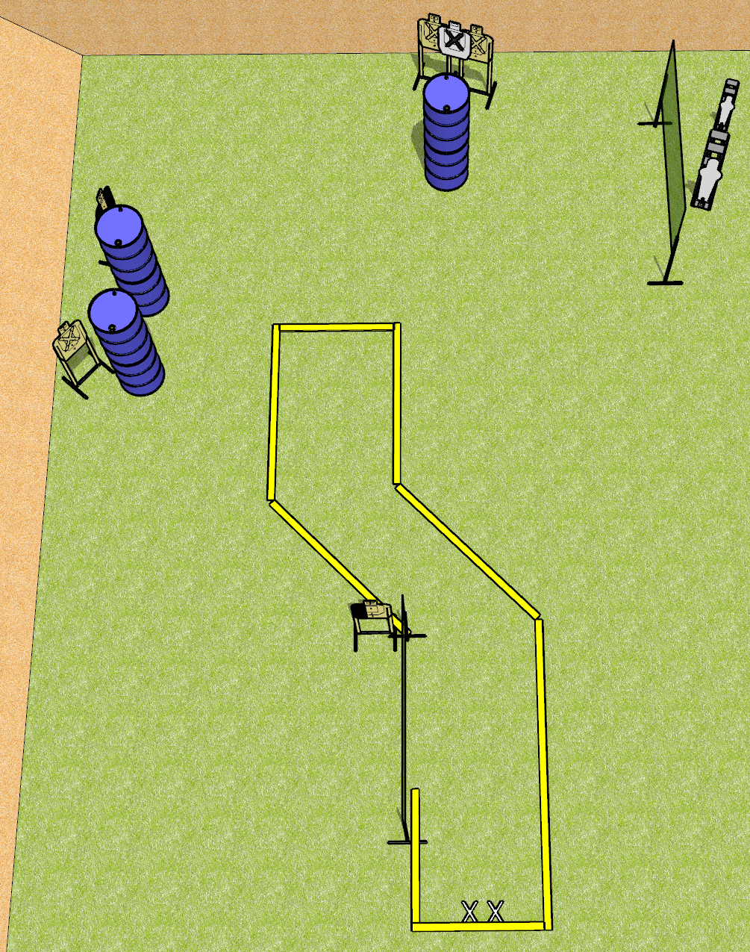
 | Dothan Gun Club – USPSA Match Side Step Course Designer : Drew Coleman
START POSITION : Standing facing uprange, feet on X’s, toes against rear fault line. Wrists above respective shoulders
GUN READY CONDITION : Pistol loaded and holstered. PCC shouldered facing downrange, buttstock on belt, heels on rear fault line |  | SCORING: Comstock, 12 rounds TARGETS: 5 paper, 2 Steel SCORED HITS: Best 2 on paper, steel until down START-STOP: Audible, last shot RULES:
STAGE PROCEDURE: Engage targets as they become available from within the fault lines

